Slide 1

Staff awareness of the Sustainable Development Goals (SDGs) at Australia’s newest university: Professional learning implications
Peter Kilgour, Maria Northcote, Jason Morton, Jenna Lynne and Adelle Faull
Avondale University, Lake Macquarie Campus, NSW
Abstract no. 75, Virtual 1.1 Showcase presentation, 11.45-12.10am, Wednesday 5 July 2023

Slide 2

Acknowledgement of country
I’d like to respectfully acknowledge the Awabakal and Darramuragal people as the traditional custodians of the lands on which we live, work and study across our Lake Macquarie and Sydney campuses. We pay our respects to Elders past, present and emerging, and extend that respect to all First Nations People.

Slide 3

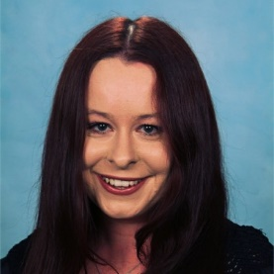
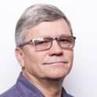
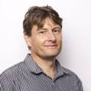

SDG team @ Avondale University
Maria
Northcote
Jenna
Lynn
Peter
Kilgour
Jason
Morton
Adelle
Faull

Slide 4
What are the
Sustainable Development goals (SDGs)?
In the words of the United Nations:
“The Sustainable Development Goals are the blueprint to achieve a better and more sustainable future for all. They address the global challenges we face, including poverty, inequality, climate change, environmental degradation, peace and justice.”
https://www.un.org/sustainabledevelopment/sustainable-development-goals/

Slide 5
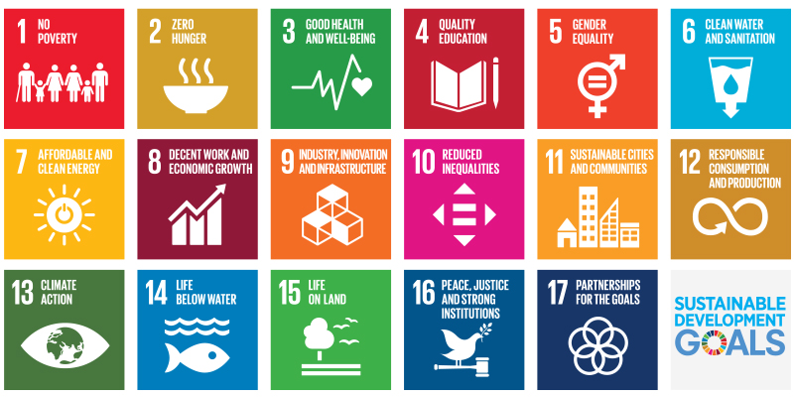
What are the
Sustainable Development goals (SDGs)?

Slide 6

What are the
Sustainable Development goals (SDGs)?
Which of the SDGs do you think would be most relevant to your university?
Choose which SDG is most relevant to you?

Slide 7
17 SDGs
Which SDG – most relevant to your university?
Which SDG – most relevant to you? (=> in the Chat)
No poverty
Zero hunger
Good health and wellbeing
Quality education
Gender equality
Clean water and sanitisation
Affordable and clean energy
Decent work and economic growth
Industry innovation and infrastructure
Reduced inequalities
Sustainable cities and communities
Responsible consumption and production
Climate action
Life below water
Life on land
Peace, justice and strong institutions
Partnerships for the goals

Slide 8
What are other universities doing about the SDGs?
Universities contribute to the SDGs in four main ways:
Learning and teaching
Research
Operations
Community leadership

Slide 9
What are other universities doing about the SDGs?
Universities contribute to the SDGs in four main ways:
Learning and teaching
      Improved employment, health and wellbeing, gender equality, understanding SDGs
      Example: Western Sydney University – Excellence awards
Research
      Promoting and aligning to SDGs
      Example: University of Technology Sydney –
      Developing technologies to transform sewage treatment plants into green energy producers (Prof. Qilin Wang)

Slide 10
What are other universities doing about the SDGs?
Universities contribute to the SDGs in four main ways:
Operations
      Aligning governance, culture and operations to the SDGs
      Example: Macquarie University – Shifting to the renewable energy provider Red Energy in 2020
Community leadership
      External advocacy of the SDGs
      Example: University of Sydney – FoodLab Sydney supports food entrepreneurs from disadvantaged backgrounds

Slide 11
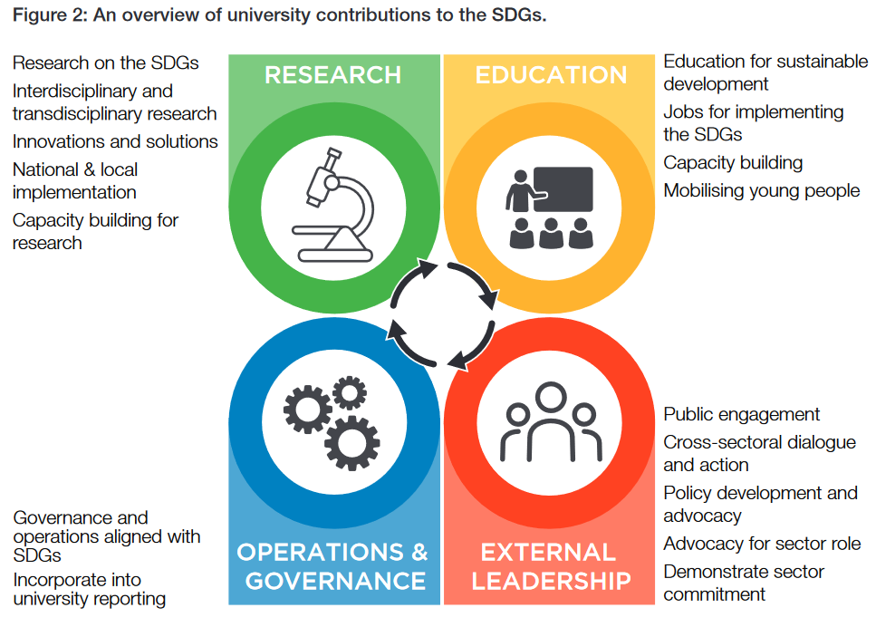
Source: Getting started with the SDGs in Universities

Slide 12
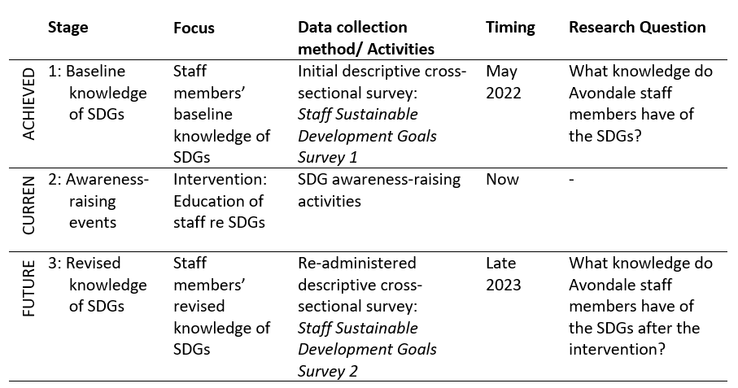
The initiative
Overall methodological approach:
a descriptive cross-sectional survey study
3 phases: survey-intervention-survey
Aim: capacity building

Slide 13
Who contributed to phase 1
We invited all staff to contribute to our online questionnaire in Phase 1
Cross-sections of full-time and part-time staff:
  Professional staff
  Academic staff
  Administration (leadership)
All staff (n = 150) were invited to contribute to the questionnaire.
74 staff responded (40 professional, 25 academic, 9 staff unknown status)
Almost 50 % response rate

Slide 14
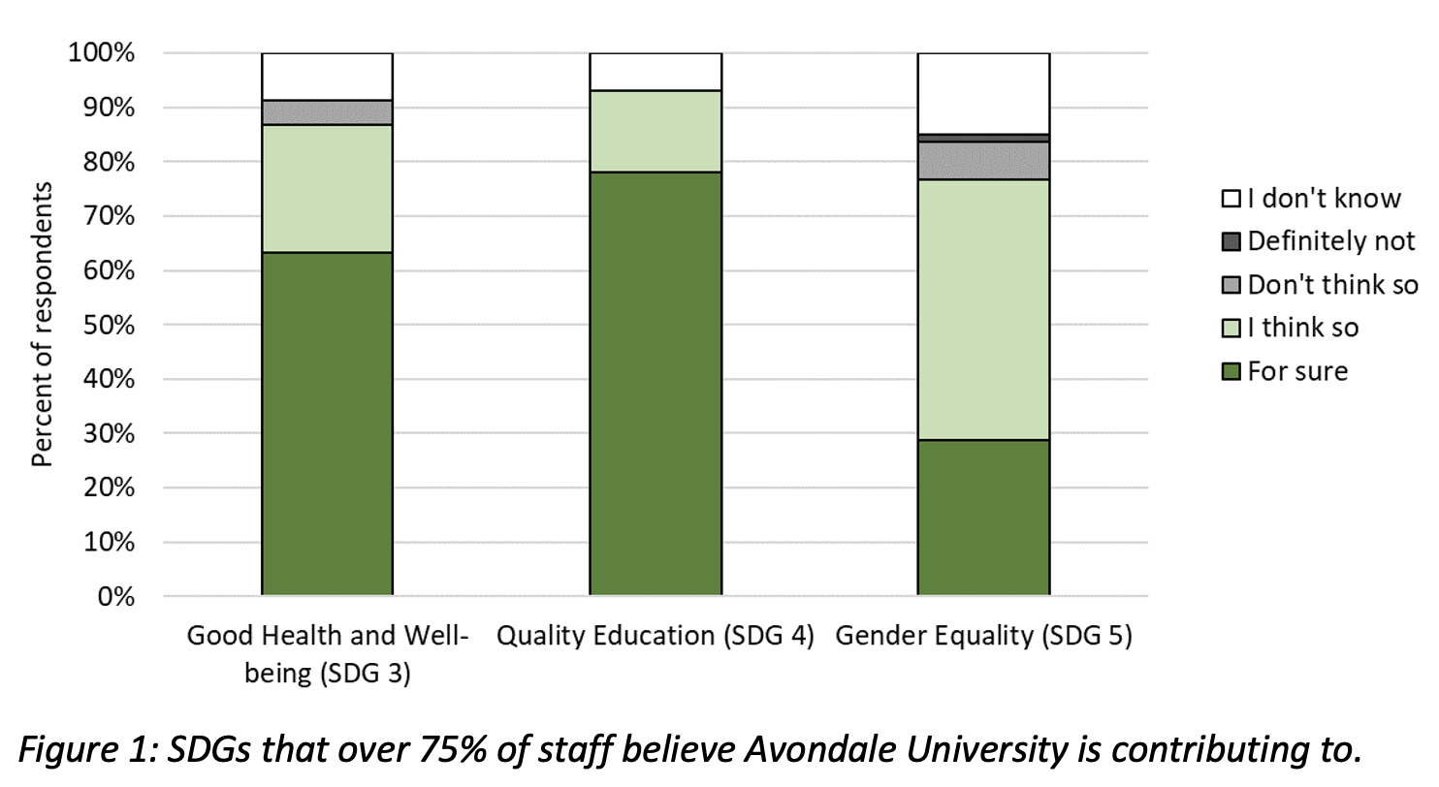
Outcomes of phase 1
Provided information about staff knowledge of the SDGs + practices Avondale University already has in place that relate to the SDGs
Data shows most staff tried to relate to sustainability and SDGs
Data in Figure 1 indicates staff believe Avondale University is significantly contributing to Quality Education (SDG 4) 93%, Good Health and Wellbeing (SDG 3) 87% and Gender Equality (SDG 5) 77%

Slide 15
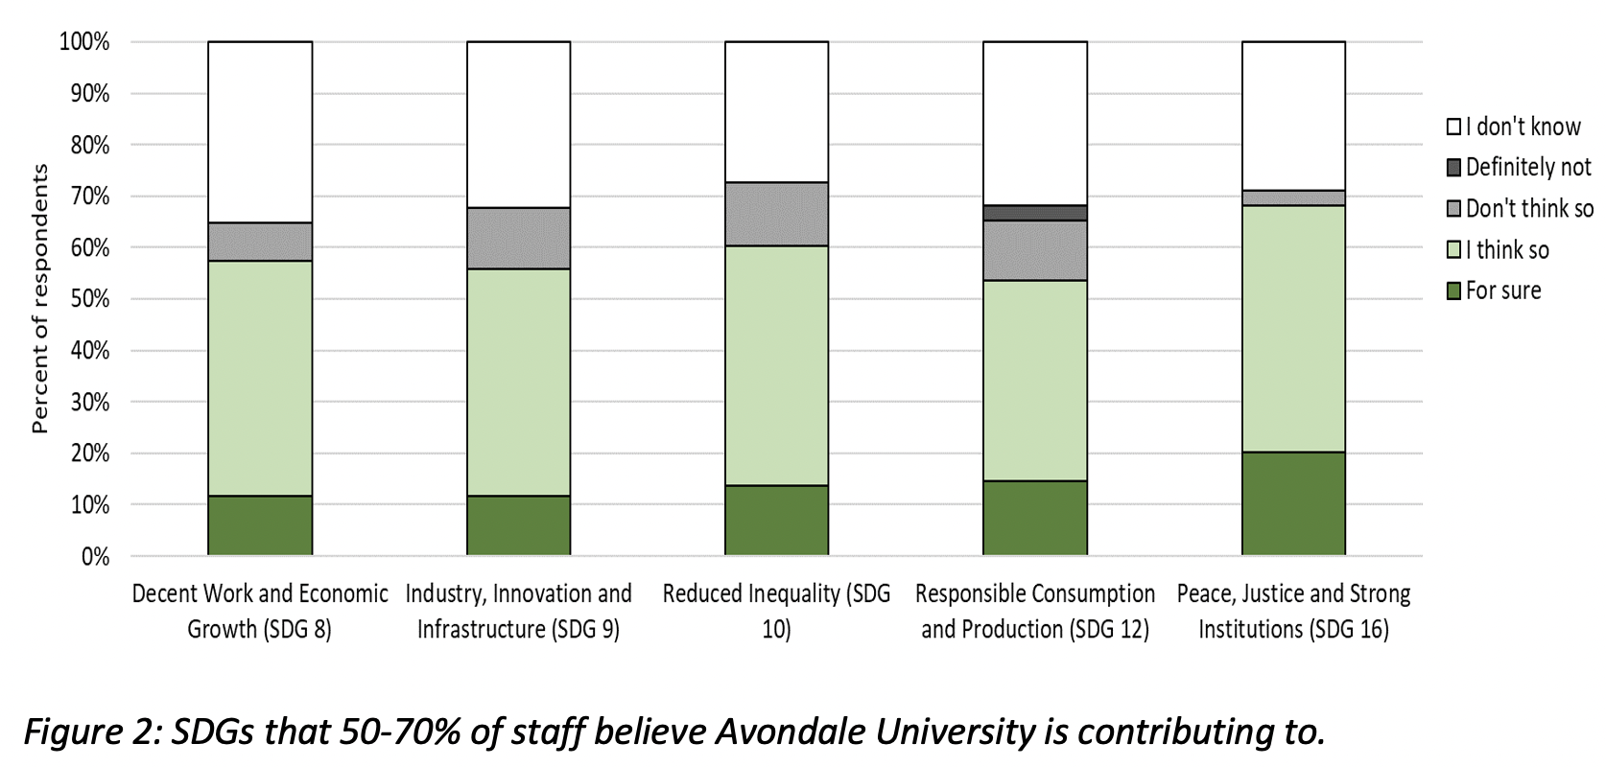
Outcomes of phase 1 (cont.)
Five SDGs were identified as those Avondale University contributes to quite well (refer to Figure 2)
Less than 50% of all staff believe Avondale University is contributing to the remaining nine SDGs
Evidence we need to communicate more about our alignment to these SDGs

Slide 16
Phase 2: what we’re doing now
Currently in the “raising awareness” stage.
Activities and events:
Links to SDGs in our course materials (e.g., unit outline)
Addition of regular SDG-related item on key meeting agendas (e.g., Academic Board, School meetings)
Signage on campus (underway)
SDG presentation by team member at staff professional learning day on 31 January 2023

Slide 17
Phase 2: what we’re doing now (cont.)
Currently in the “raising awareness” stage.
Activities and events (cont.):
Identify key stakeholders and potential champions for the SDGs
Stocktake of contributions toward the SDGs from the areas of learning and teaching, research, operations and community leadership.
Identify potential areas for greater SDGs support
Promotion and awareness presentation of SDGs during Learning and Teaching Festival (Oct 9-13)

Slide 18
Phase 3: what we’re doing next
Consolidation:
Seeking out ways of getting staff to identify with the SDGs
Introduce SDGs into documentation including unit information and research projects.
Make SDGs a standing item on committees.
Install signage on shared community/university walkways that link campus and research projects to specific SDGs.
Implement a follow-up data collection stage to reassess staff awareness of the SDGs

Slide 19

want to join us? Replicate the study?
An invitation …
If you’d like to find out more …
If you’d like to join us in this project …
If you’d like to replicate the study …
Please contact Maria: maria.northcote@avondale.edu.au

Slide 20
Some key references
Purcell, W. M., Henriksen, H., & Spengler, J. D. (2019). Universities as the engine of transformational sustainability toward delivering the sustainable development goals: “Living labs” for sustainability. International Journal of Sustainability in Higher Education, 20(8), 1343-1357. https://doi.org/10.1108/IJSHE-02-2019-0103
United Nations. (2023). United Nations: Academic impact - Capacity-building. United Nations. Retrieved 31 March from https://www.un.org/en/academic-impact/capacity-building
Waas, T., Verbruggen, A., & Wright, T. (2010). University research for sustainable development: definition and characteristics explored. Journal of Cleaner Production, 18(7), 629-636. 629-636. https://doi.org/10.1016/j.jclepro.2009.09.017
World Health Organization. (2023). World Health Organization: Capacity building and collaboration. World Health Organization. Retrieved 31 March from https://www.who.int/teams/digital-health-and-innovation/capacity-building

Slide 21
Thank you,
Questions?
Maria
Northcote
Jenna
Lynn
Peter
Kilgour
Jason
Morton
Adelle
Faull

