Slide 1

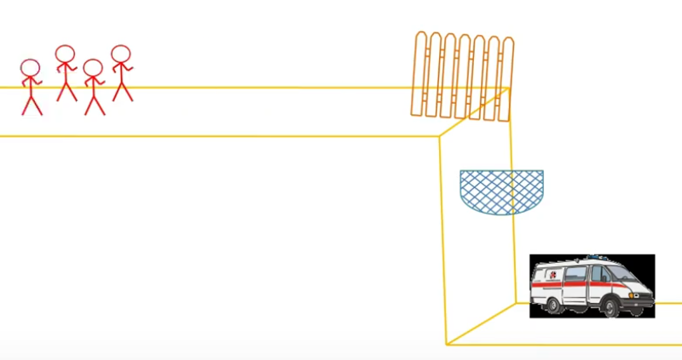


The influence of three modes of human support on the effectiveness of an online mental health promotion intervention: A randomised comparative study
WHO Mental Health Action Plan: 2013-2020:
“There is no health without mental health”
Key objective: Mental health promotion (MHP)
Mobile technologies → maximise accessibility
MHP: Enhance mental wellbeing
Vital BUFFER against common mental health disorders
Renfrew, M., Morton, D., Morton, J., Hinze, J., Beamish, P., Przybylko, G.,
Lifestyle Research Centre, Avondale College of Higher Education, Cooranbong, NSW, AUSTRALIA
Graphic adapted from: (DocFlea, 2017, Youtube)
Notes:
Slide 1 Title Slide - Introduction

Slide 2

Mental Health Promotion
A ‘healthy’ (i.e. non-clinical) cohort
APS Stress & Wellbeing Survey -2015
    26% above normal anxiety
    26% moderate to extreme depression
    35% significant distress levels
NZ Wellbeing & Mental Distress in NZ – 2016 Snapshot
    80% experience of mental distress
    Overwhelmed with stress
    Feeling isolated
    Inability to cope

Slide 3
Mental Health Promotion
Online Delivery with Human Support
Digital Delivery = Opportunities
✓Accessibility ✓Scalability ✓ Cost effective
Learnings from online interventions for clinical cohorts:
Lack of adherence & high attrition rates
Human support (i.e. guidance)
May improve adherence & outcomes
Clinical studies - results are mixed
Numerous human support variables to consider:
  Synchronicity
  Mode
  Intensity
  Who provides
¹ (Morton et al., 2017) ² (Hinze & Morton, 2017) ³ (Przybylko et al., 2018)

Slide 4
Purpose of the study
The role of human support
Clinical Cohort | Non-clinical Cohort
Disorder symptoms: Weakened motivation Apathy Malaise Despondency Anxiety | Little or no inhibiting symptoms
To compare the influence of three modes of human support on the outcomes of a 10-week web- and mobile-app-based, lifestyle-focused, mental health promotion intervention for a healthy adult cohort.

Slide 5
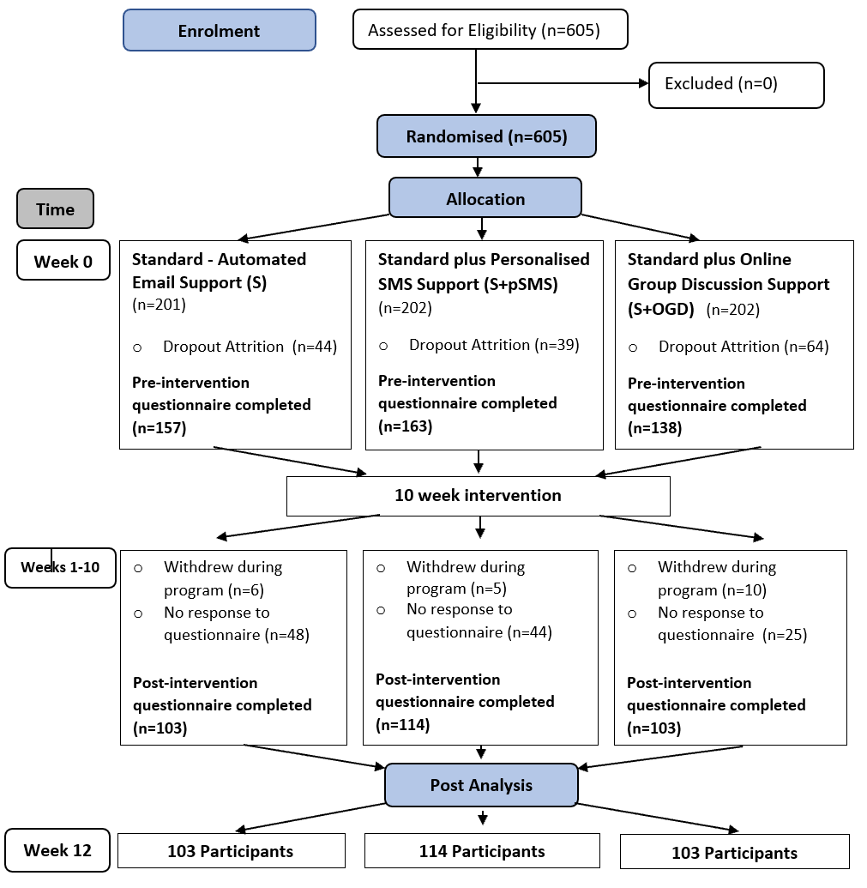
Methodology
Study Design & Flow Chart
Multi-arm, randomised comparative trial
Three groups - differ according to human support mode:
  Group 1: Standard –automated emails & helpdesk (S)
  Group 2: Standard + personalised SMS messages (S+pSMS)
  Group 3: Standard + weekly, facilitated online group discussion (i.e. videoconferencing) (S+OGD)
Notes:
This will be a multi-arm, randomised comparative trial where 500 participants will be randomised into three intervention groups that differ according to levels of human support
Group 1 – Standard – includes automated emails & a technical helpdesk
Group 2 – Standard + personalised SMS support messages (2-3 times a week)
Group 3 – Standard + weekly, facilitated online group discussion (i.e. videoconferencing)
Looking at the flow chart….500 participants will be randomised into three arms. The questionnaire (7DWI) will be administered before commencing the Live More Project, immediately after and again at 6 months to determine what effects have been maintained.

Slide 6

The intervention
“Live More Project” or “Lift Project”
Combines strategies from Lifestyle Medicine & Positive Psychology
30 minutes audio-visual content
Experiential learning - daily & weekly challenges
Improvements – Effect sizes (Cohen’s D)
Domain: Pilot 2016¹ Pilot 2017 ² I-RCT ³ C-RCT
Mental Health 0.95 0.75 0.52 0.13
Vitality 0.49 0.64 0.56 0.11
Depression 0.34 0.32 0.40 0.09
Anxiety 0.39 0.41 0.33 0.05
Stress 0.57 0.38 0.45 0.13
Life Satis. 0.33 0.34 0.32 0.14

Slide 7
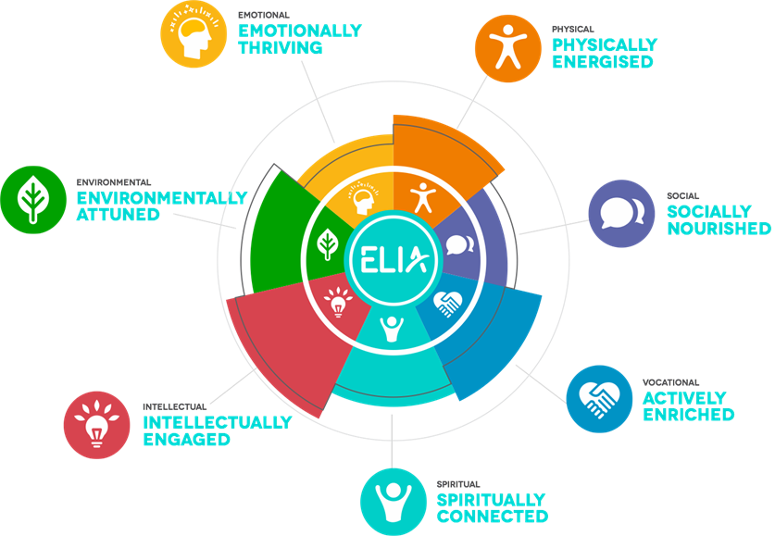
Methodology
Measurement
Mental wellbeing
36-Item Short Form Survey (SF-36)
Depression Anxiety and Stress Scales (DASS-21)
Satisfaction With Life Scale
Flourishing Scale
Measurement domains:
Mental health SF-36
Vitality SF-36
Depression DASS-21
Anxiety DASS-21
Stress DASS-21
Satisfaction with Life Diener (1985)
Flourishing Diener (2010)
Notes:
Participants will complete a questionnaire called the 7 Dimensions of Wellness Index (7DWI). The questionnaire combines demographic and lifestyle related questions with various, freely available, validated instruments.
Emotional or mental wellbeing will be the focus of this study and data will be utilised from three of the validated instruments within the questionnaire: the Short Form 36 (SF-36), the Depression Anxiety and Stress Scales (DASS-21), and the flourishing scale by Huppert & So (2013).
The following domains will be measured:
Mental health SF-36
Vitality SF-36
Depression DASS-21
Anxiety DASS-21
Stress DASS-21
Flourishing (Huppert & So, 2013)

Slide 8
Results
Within & Between Group
Within Group
Significant improvements for every outcome measure (p<0.001)
Between Group
No significant between group differences in outcomes
Mental health (p=0.77)
Vitality (p=0.65)
Depression (p=0.93)
Anxiety (p=0.25)
Stress (p=0.57)
Satisfaction with Life (p=0.65)
Flourishing (p=0.99)
Improvements were made in every group, irrespective of human support
Notes:
Participants will complete a questionnaire called the 7 Dimensions of Wellness Index (7DWI). The questionnaire combines demographic and lifestyle related questions with various, freely available, validated instruments.
Emotional or mental wellbeing will be the focus of this study and data will be utilised from three of the validated instruments within the questionnaire: the Short Form 36 (SF-36), the Depression Anxiety and Stress Scales (DASS-21), and the flourishing scale by Huppert & So (2013).
The following domains will be measured:
Mental health SF-36
Vitality SF-36
Depression DASS-21
Anxiety DASS-21
Stress DASS-21
Flourishing (Huppert & So, 2013)

Slide 9
Results – Focus on Online Group Discussion
Stratification
Total OGD Attendance (/10 Zoom meetings)
18% - =>7 sessions
54% - =1-6 sessions
36% - = 0 sessions
Stratification
Compare =>7 sessions with =6< sessions
Greater Improvements P Cohen’s D
Mental health (P=0.006) 0.71
Vitality (P=0.005) 0.73
Depression (P=0.04) 0.54
Satisfaction with Life (P=0.046) 0.50

Slide 10
Conclusions
The findings further strengthen the rationale for online MHP initiatives
A web- and app-based, lifestyle focused intervention improved the wellbeing of a healthy cohort, irrespective of human support
SMS messages provided no significant benefit over automated emails
Online group discussions (i.e. videoconferencing), as a means of support, might enhance outcomes if engagement can be optimised

Slide 11
References

Slide 13
Notes:
Qualitative systematic review – 64 studies – adherence improved by support of counsellors, peers, phone, email contact & website updates (Brouwer et al., 2011)
Systematic reviews – supported interventions – greater retention & outcomes (high heterogeneity) (Baumeister et al., 2014; Johansson & Andersson, 2012; Richards & Richardson, 2012)

