Slide 1




Making use of the self-determined learning principles of heutagogy to support academic staff who are learning to teach online
Chris Boddey and Maria Northcote
Avondale College of Higher Education, NSW

Slide 2
Teaching staff technology adoption continues at a slow pace and often does not involve effective, transformative practices
(Torrisi-Steele & Drew, 2013)
Chris Boddey and Maria Northcote
Avondale College of Higher Education, NSW
Notes:
.. there is strong international pressure to mainstream online learning methodologies alongside the growing demand for learner-centred online learning opportunities (New Media Consortium - (Johnson, Becker, Cummins, & Estrada, 2014; Johnson, Becker, Estrada, & Freeman, 2014) However the challenge lies in addressing the low digital literacy amongst teaching staff.
Blended learning innovations: Leadership and change in one Australian institution
Negin Mirriahi, Dennis Alonzo, Simon McIntyre, Giedre Kligyte and Bob Fox University of New South Wales

Slide 3
…while educational technology integration in course design in some higher education institutions remains conservative, students continue to prefer more technology-enhanced learning experiences.
Chris Boddey and Maria Northcote
Avondale College of Higher Education, NSW
Notes:
.. there is strong international pressure to mainstream online learning methodologies alongside the growing demand for learner-centred online learning opportunities (New Media Consortium - (Johnson, Becker, Cummins, & Estrada, 2014; Johnson, Becker, Estrada, & Freeman, 2014) However the challenge lies in addressing the low digital literacy amongst teaching staff.
Blended learning innovations: Leadership and change in one Australian institution
Negin Mirriahi, Dennis Alonzo, Simon McIntyre, Giedre Kligyte and Bob Fox University of New South Wales

Slide 4
What?
Professional learning/development – academic staff developing knowledge and skills in online teaching and online course design
Avondale – Higher education institution (pre-tertiary through to Masters and PhD courses) at Lake Macquarie campus, NSW
Academic staff– 69 academic staff (175 staff in total)
Online PD resource – Moodle’s Little Helper
Drawing on theories of
  Heutagogy (Hase, 2009; Hase & Kenyon, 2003): a self-determined learning theory
  Capacity-building PD programs (for example, Symes, 2005)
  Utilisation-focused research methodology (Patton, 2011)
  Learning about online teaching by being an online learner (Salmon, 2013)
4

Slide 5
You? Learning to teach online … Your preferred PD method?
On-campus interactive workshop in a small group
One-to-one consultation with professional development officer
Self-help online instructions
View examples of exemplars (good practice)
Online course (across a few weeks)
Face-to-face study group (across a few weeks)
Research project
Audio podcast
Video tutorials
Shadowing an experienced colleague
Face-to-face lecture presentations
Webinar
Attendance at a conference
Other?
Add a Poll everywhere (choose 2 or 3)
Plan B: hands up, chat
5

Slide 6

Notes:
When participating in professional development I prefer...
https://www.polleverywhere.com/multiple_choice_polls/lQKS5lHwBlgdmXQ

Slide 7
Context and the problem
Small institution
Minimal professional learning support
Past: suspicion about online learning (attitudes)
Current: Staff keen to improve knowledge, skills
Other research: threshold concepts in online teaching (since 2010)
Researcher’s Little Helper: Similar resource for postgraduate supervisors and candidates
Needed an approach that would capitalise on current needs but assist in developing autonomy
7
Notes:
High PD demand, low resources

Slide 8
Research questions
What are the needs of academic staff as they develop online course design and teaching skills?
How can varied needs of academic staff be incorporated into an online self-help support resource?
How is the self-help resource used by academic staff to develop online course design and teaching skills?
8

Slide 9
Theoretical and methodological foundations
Heutagogy: self-help nature of the theory;
  "recognizes that people learn when they are ready and that this is most likely to occur quite randomly, chaotically and in the face of ambiguity and need" (Hase & Kenyon, pp. 3-4)
  "when there is a gap in understanding that creates curiosity, confusion or a gentle unease" (Hase, 2009, p. 44)
Evaluation-focused research design (Patton, 2011): guided:
  the development of the content and structure of resource
  the evaluation of the content and structure of resource
Go over this quickly
9

Slide 10
Stages of the study
Stage 1 | 2011-2012 | Problem defined in consultation with practitioners (online educators)
Stage 2 | 2012 | Prototype 1 of the resource was created and made available for use and evaluation
Stage 3 | 2012-2013 | Evaluation processes identified and administered to gather feedback data (evaluation surveys; reflection journals; learner analytics in LMS; and Help Desk data) which were analysed using research questions as interrogation tools to determine future resource modifications
Stage 4 | 2013-2014 | Outcomes of data analysed from Stage 3 were incorporated into Prototype 2
Current | 2015+ | Ongoing development
10

Slide 11

The resource
11
Notes:
Within the institution’s LMS: http://moodle.avondale.edu.au/course/view.php?id=1317

Slide 12
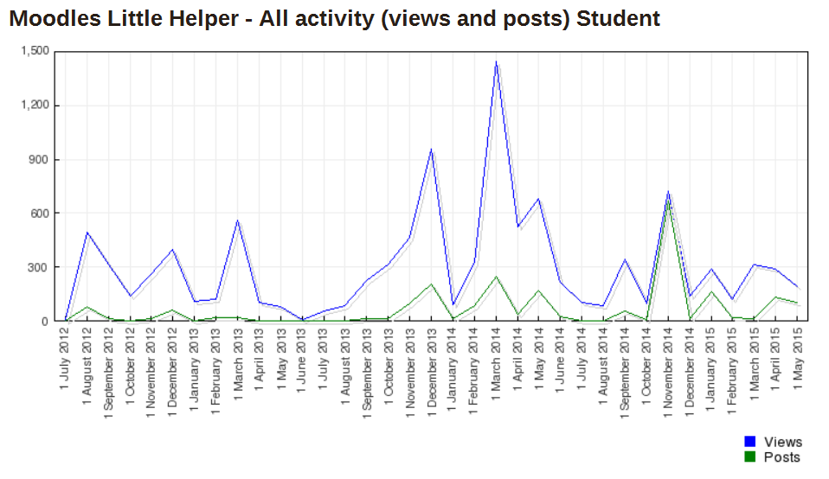
Use of the resource
12

Slide 13
Most accessed components
Category | Component | No. of hits
Workshop material | Materials for on-campus PD Workshops 12-13 Feb 2014 | 1355
2014 Showcase | Learning and Teaching Week : Blended Learning Showcase October 2014 | 1048
Exemplars (internal) | Showcase of Avondale's online learning courses and activities | 637
Workshop material | Materials for on-campus PD Workshops in Sem 1 2014 | 412
Institution's template | Moodle Template Instructions | 404
Turnitin training | Turnitin - Submit Assignment 1 | 258
Exemplars (external) | Webquest activity: Investigating good online courses | 245
Turnitin training | Workshop Submission | 214
Turnitin training | SUBMIT HERE: Assignment 1: Clinical Report | 151
Forum | Week 1 icebreaker forum: What's outside your window? | 150
Graphic enhancement | Banner making site | 113
Might need to update
this screenshot
13
Notes:
According to LMS analytics, the resource recorded almost 1500 hits between February and March 2014.

Slide 14
Outcomes
Greater reach and facilitated autonomy
Understanding + skills => disposition about online learning
Grazing, drilling, targeting
Quick feedback about what is needed
Part of wider PD strategy
Moodle’s Little Helper is now one of two in a suite (no. 2: Researcher’s Little Helper)
14

Slide 15
Discussion
How can Moodle facilitate effective ICT integration?
Ongoing threshold concepts, skills & attitudes
Notes:
Blended learning innovations: Leadership and change in one Australian institution (Negin Mirriahi, Dennis Alonzo, Simon McIntyre, Giedre Kligyte and Bob Fox University of New South Wales, Australia)
Providing teaching staff with authentic blended and online learning experiences, using the same technologies that they could use in their actual teaching practices, can be an effective professional development strategy (Ertmer et al., 2012)
…build their confidence and awareness of effective flexible learning and teaching strategies (Atkinson, Fluker, Ngo, Dracup, & McCormick, 2009)
…establish online communities that can encourage ongoing access to resources, support, and sharing of knowledge (Glitz, 2013).
… raise awareness of the benefits of effective online learning strategies by providing a range of opportunities for professional development and establishing institutional policies and strategic initiatives (Garrison & Vaughan, 2011).
Our further research - exploring what key threshold concepts and related issues are at play as staff develop greater experience in online education
- varying progress made by academic staff in terms of the mastery of threshold concepts and the development of self-efficacy in relation to the delivery of online learning
… notes the close association of threshold attitudes, values and emotions with the concept of threshold concepts as matters that must be addressed in staff development
…. the need for continuing research into the threshold attitudes, values, emotions and concepts that underpin the progress of academic staff in online learning in order to ensure that professional development maintains currency with where teaching staff are at in their own journey
…. The need for a more holistic approach to staff professional development emerges…addressing not just threshold concepts but also threshold attitudes, values and emotions

Slide 16
References
Hase, S. (2009). Heutagogy and e-learning in the workplace: Some challenges and opportunities. Impact: Journal of Applied Research in Workplace E-learning(1), 1.
Hase, S., & Kenyon, C. (2003, 25-27 September). Heutagogy and developing capable people and capable workplaces: Strategies for dealing with complexity. Paper presented at the Proceedings of The Changing Face of Work and Learning Conference, Alberta, Canada.
Patton, M. Q. (2011). Essentials of utilization focused evaluation. London: Sage Publications.
Salmon, G. (2013). E-tivities: The key to active online learning (2nd ed.). London and New York: Routledge.
Symes, A. (2005). Towards a framework for quality promotion and capacity development in South African higher education. A report for the QPCD Framework. Pretoria, South Africa: The Council on Higher Education.
16

