Slide 1


Using the grassroots approach: Incorporating recent graduate researcher voices in the design and delivery of research supervisor training
Presenter: Maria Northcote
Researchers: Carie Browning, Judy Elisha, Lavarah Haihavu, Peter Kilgour, Lynnette Lounsbury, Alice Napasu, Maria Northcote, Carolyn Rickett, David Sailo and Carol Tasker

Slide 2
Acknowledgement of country
On behalf of our research team, I would like to acknowledge the traditional owners and custodians of the Darkinjung, Awabakal and Durramurragal lands on which my colleagues and I work. We’d like to pay our respect to Elders, past, present and emerging.
We recognise the continued connection to these lands, waterways and skies, and extend this acknowledgement to the homelands and stories of those who call these places home.
Slide no. 2

Slide 3

The beginning
Slide no. 3

Slide 4
Acknowledgement – Funding
Joint government funding program: Academic Strengthening Project
Capacity-building novice supervisors: Developing and implementing a co-designed supervision training program using a participatory approach.
2 leaders, 2 universities, 2 teams of 5 members =
10 researchers
Slide no. 4

Slide 5
NSW - PNG
Develop professional learning activities and resources
Supporting and extending the development of supervisors’ capacity to supervise postgraduate students
Two universities working together (cross-cultural, cross-country, varied levels of experience, varied levels of access to technology, varied forms of workloads)
Slide no. 5

Slide 6
Role of novice in the definition of an expert
Experienced supervisors
Literature (previous researchers’ findings)
Identified experts in supervisor education
Novice supervisors
Slide no. 6

Slide 7
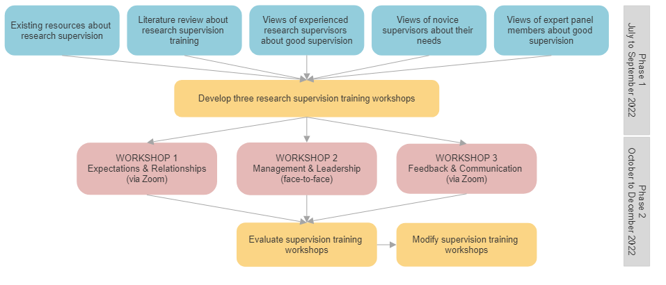
Methodology
2 phase participatory research methodology:
Collaboration, co-construction
Slide no. 7

Slide 8
Data collection
Data collection instrument | Focus | Data collected | Participants
Questionnaire | Self-reported supervision skills and needs | Likert-style responses | Novice research supervisors (n=11)
1:1 Interviews |  | Open-ended responses
Questionnaire | Perceived supervisors’ needs and workshop design | Likert-style responses | Experienced research supervisors (n=8)
Focus group interviews |  | Open-ended responses
Panel discussion | Perceived supervision needs of effective supervisors | Responses to discussion questions | Expert panellists (n=4)
Questionnaire | Self-reported supervision skills and future needs | Likert-style responses | Novice research supervisors (n=11)
Interviews |  | Open-ended responses
Questionnaire | Evaluation of each workshop | Open-ended responses
Panel discussion | Perceived workshop impact and future supervisors’ needs | Responses to discussion questions | Expert panellists (n=4)

Slide 9
Outputs
Suite of collaboratively designed supervisor training workshops (bespoke training)
  Expectations and relationships between supervisors and candidates
  Management and leadership of candidate waypoints and progress
  Feedback and communication during HDR supervision
Collection of resources that support supervisor education:
  Existing resources (typically shared by other universities)
  Tailored resources for each university’s research supervisors
Slide no. 9

Slide 10

Slide no. 10

Slide 11
Findings
Slide no. 11

Slide 12
Findings
Slide no. 12

Slide 13
Findings
Most useful aspects of workshops:
Interactivity
Consultation with other supervisors
Bespoke nature (met supervisors’ needs)
Importance of:
Role of each supervisor’s background
Community of practice for supervisors
Human-ness as a supervisor quality
Slide no. 13

Slide 14
Final recommendations (1)
Engaging novice supervisors in the design of their own supervisor training (not just by experts):
Ask first, design later, be willing to continue modifications
OK for some activities to fail (as long as you ask why)
Participants like to recognise their design
Choice is important (novice supervisors’ agency)
More interaction with experienced supervisors
Articulation of knowledge and acknowledgement of a lack of knowledge
Slide no. 14

Slide 15
Final recommendations (2)
Developing professional learning for research supervisors across varied cultural contexts:
Cultural knowledge of partners, supervisors, candidates
Facilitation of activities that are owned by participants
Openness and analysis of “offence”
Assisting in future partnerships with partners in the Pacific
Methodology may be replicated, results may not
Slide no. 15

Slide 16

Where to from here?
Review of current suite of workshops for novice and experienced HDR supervisors
Mentoring – Novice, experienced supervisors
Continued input of current supervisors into professional learning activities
Slide no. 16

Slide 17
Feedback ?
Questions ?
Comments ?
Slide no. 17

Slide 18
References
Anderson, T., & Shattuck, J. (2012). Design-based research: A decade of progress in education research? Educational Bergold, J., & Thomas, S. (2012). Participatory research methods: A methodological approach in motion. Historical Social Research/Historische Sozialforschung, 37(4), 191-222.
Bruce, C., Bell, J., Gasson, S., Geva, S., Kruger, K., Oloyede, K., O’Shea, P., & Wissler, R. (2009). Towards a pedagogy of supervision in the technology disciplines. www. olt. gov. au/resource-‐towards-‐pedagogy-‐supervision-‐qut-‐2009
Fossland, T. (2023). Becoming a professional supervisor: Doctoral supervisors’ development in a mandatory, large-scale development programme. Journal of Praxis in Higher Education, 5(2), 27-52.
Vereijken, M. W., van der Rijst, R. M., van Driel, J. H., & Dekker, F. W. (2018). Novice supervisors’ practices and dilemmatic space in supervision of student research projects. Teaching in Higher Education, 23(4), 522-542.
Slide no. 18

